Slide 1
Interactive Utility Application for Discounts and Random Number Generation Description: This project is an interactive console-based application that provides two core functionalities:
Sales Discount Calculator – Calculates a discount based on the total price of items entered by the user.
Random Number Generator – Generates a random number between 1 and 100 for entertainment or utility purposes.

Slide 2
Sudo Code
print name
loop name
enter name again
outputs welcome
type 1 2 3
1 calc sales tax
2 calc equation
3 end
2 goes into conditions about the sales tax
and 3 goes into equation solving
output answers
end codes here

Slide 3
import random
def calculate_discount():
total_price = 0
print("Enter the price of each item. Type '0' when done.")
while True:
try:
price = float(input("Enter price: "))
if price == 0:
break
elif price < 0:
print("Price cannot be negative. Try again.")
continue
total_price += price
except ValueError:
print("Invalid input. Please enter a number.")
if total_price == 0:
print("No items entered. No discount applied.")
return
if 0 <= total_price <= 50:
discount_rate = 0.10
elif 51 <= total_price <= 75:
discount_rate = 0.15
else:
discount_rate = 0.20
discount = total_price * discount_rate
new_total = total_price - discount
print(f"Original Total: ${total_price:.2f}")
print(f"Discount ({int(discount_rate * 100)}%): -${discount:.2f}")
print(f"New Total: ${new_total:.2f}")
def random_number_generator():
random_number = random.randint(1, 100)
print(f"Your random number is: {random_number}")
while True:
name = input("Enter your name: ")
print(f"Hello, {name}!")
print("Welcome! What can I help you with today?")
while True:
print("\nOptions:")
print("1. Calculate Sales Discount")
print("2. Generate a Random Number")
print("3. Exit the Program")
choice = input("Please select an option (1, 2, or 3): ")
if choice == '1':
calculate_discount()
elif choice == '2':
random_number_generator()
elif choice == '3':
print("Thank you for using the program. Goodbye!")
exit()
else:
print("Invalid choice. Please try again.")
continue
more_help = input("\nDo you need help with anything else? (yes or no): ").strip().lower()
if more_help != 'yes':
print("Thank you for using the program. Goodbye!")
exit()

Slide 4
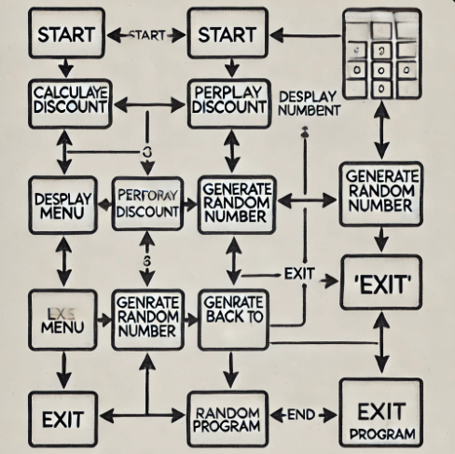
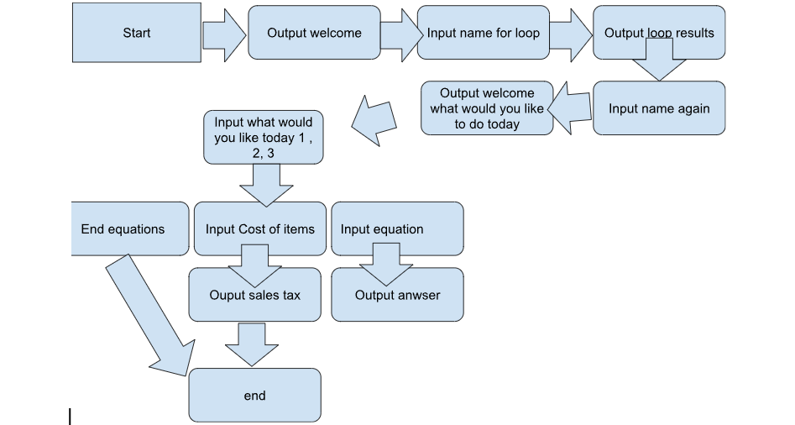

Slide 5
Business Logic
The code can be adapted and used in a business context to provide basic functionality for customer service, sales, or internal operations.
Real-World Scenario
Scenario: The application can be used by small business owners or customers to calculate potential discounts on purchases or entertain themselves with random numbers while waiting in queues.

Slide 6
Concepts Demonstrated:
Arithmetic Expressions: Used to calculate the total price, discount rate, and final price.
Conditions: Implements tiered discount logic and input validation.
Loops: Allows the user to input multiple item prices and choose options repeatedly.
Lists: Could be enhanced by storing item prices for further analysis or reporting.
Methods: Modular functions (calculate_discount, random_number_generator) separate core features for clarity and reusability.
Implementation Plan:
Create a user-friendly menu system to guide user interactions.
Implement a loop for continuous input and program navigation until the user chooses to exit.
Design individual functions to handle discount calculation and random number generation.
Test the program for edge cases, such as invalid inputs or no items entered.

Slide 7
2. What Does the Application Do?
Input:
For the Discount Calculator: User enters the prices of items individually until they indicate completion (by entering 0).
For the Random Number Generator: No input required from the user.
Users also input their name and select their desired functionality from a menu.
Processing:
Sales Discount Calculation:
Accumulates the total price of items entered by the user.
Applies a tiered discount system based on the total:
10% discount for totals ≤ $50.
15% discount for totals between $51 and $74.
20% discount for totals > $75.
Random Number Generator:
Generates a random integer between 1 and 100 using Python's random library.
Output:
For the Discount Calculator:
Displays the original total, discount percentage, discount amount, and the final total after discount.
For the Random Number Generator:
Outputs a randomly generated number.
The program also includes user-friendly messages and options to continue or exit.

Slide 8
https://github.com/Jkells10/Project.git

